Slide 1


Slide 2




Slide 3



EXCEPTION HANDLING
1.2

Slide 4
TRY -CATCH
Java try block is used to enclose the code that might throw an exception. It must be used within the method.
If an exception occurs at the particular statement of try block, the rest of the block code will not execute.
So, it is recommended not to keeping the code in try block that will not throw an exception.
Java try block must be followed by either catch or finally block

Slide 5
SYNTAX:
try{ //code that may throw an exception }catch(Exception_class_Name ref){}
try{ //code that may throw an exception }finally{}

Slide 6
JAVA CATCH BLOCK
Java catch block is used to handle the Exception by declaring the type of exception within the parameter.
The declared exception must be the parent class exception ( i.e., Exception) or the generated exception type.
However, the good approach is to declare the generated type of exception.
The catch block must be used after the try block only.
You can use multiple catch block with a single try block.

Slide 7
PROBLEM WITHOUT EXCEPTION HANDLING
public class Main{ public static void main(String[] args) { int data=50/0; //may throw exception System.out.println("rest of the code"); } }
Notes:
Exception in thread "main" java.lang.ArithmeticException: / by zero
As displayed in the above example, the rest of the code is not executed (in such case, the rest of the code statement is not printed).
There can be 100 lines of code after exception. So all the code after exception will not be executed.

Slide 8
SOLUTION WITH EXCEPTION HANDLING
public class Main { public static void main(String[] args) { try { int data=50/0; //may throw exception } //handling the exception catch(ArithmeticException e) { System.out.println(e); } System.out.println("rest of the code"); } }
Notes:
java.lang.ArithmeticException: / by zero
rest of the code
Now, as displayed in the above example, the rest of the code is executed, i.e., the rest of the code statement is printed.

Slide 9
EXAMPLE TO RESOLVE EXCEPTION IN CATCH BLOCK
public class Main { public static void main(String[] args) { int i=50; int j=0; int data; try { data=i/j; //may throw exception } // handling the exception catch(Exception e) { // resolving the exception in catch block System.out.println(i/(j+2)); } } }
Notes:
25

Slide 10
EXAMPLE:
public class Main{ public static void main(String[] args) { try { int data1=50/0; //may throw exception } // handling the exception | catch(Exception e) { // generating the exception in catch block int data2=50/0; //may throw exception } System.out.println("rest of the code"); } }
Notes:
Exception in thread "main" java.lang.ArithmeticException: / by zero
Here, we can see that the catch block didn't contain the exception code. So, enclose exception code within a try block and use catch block only to handle the exceptions.

Slide 11
EXAMPLE:
public class Main{ public static void main(String[] args) { try { int data=50/0; //may throw exception } // try to handle the ArithmeticException using ArrayIndexOutOfBoundsException catch(ArrayIndexOutOfBoundsException e) { System.out.println(e); } System.out.println("rest of the code"); } }
Notes:
In this example, we handle the generated exception (Arithmetic Exception) with a different type of exception class (ArrayIndexOutOfBoundsException).
Exception in thread "main" java.lang.ArithmeticException: / by zero

Slide 12
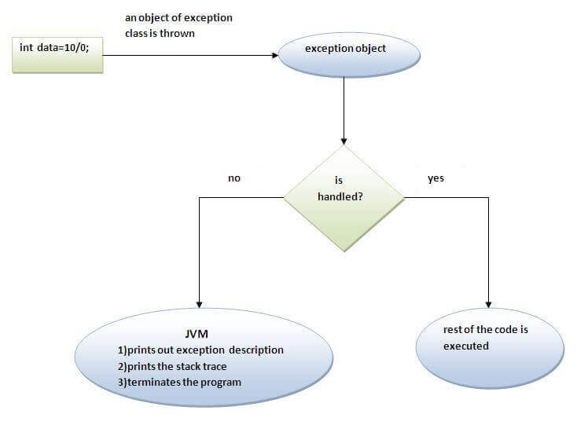
INTERNAL WORKING OF TRY-CATCH

Slide 13
MULTI CATCH BLOCK
A try block can be followed by one or more catch blocks.
Each catch block must contain a different exception handler.
So, if you have to perform different tasks at the occurrence of different exceptions, use java multi-catch block.
At a time only one exception occurs and at a time only one catch block is executed.
All catch blocks must be ordered from most specific to most general, i.e. catch for ArithmeticException must come before catch for Exception.

Slide 14
EXAMPLE:
public class MultipleCatchBlock1 { public static void main(String[] args) { try{ int a[]=new int[5]; a[5]=30/0; } catch(ArithmeticException e) { System.out.println("Arithmetic Exception occurs"); } catch(ArrayIndexOutOfBoundsException e) { System.out.println("ArrayIndexOutOfBounds Exception occurs"); | } catch(Exception e) { System.out.println("Parent Exception occurs"); } System.out.println("rest of the code"); } }
Notes:
Arithmetic Exception occurs
rest of the code

Slide 15
EXAMPLE :02
public class MultipleCatchBlock3 { public static void main(String[] args) { try{ int a[]=new int[5]; a[5]=30/0; System.out.println(a[10]); } catch(ArithmeticException e) { System.out.println("Arithmetic Exception occurs"); } catch(ArrayIndexOutOfBoundsException e) { System.out.println("ArrayIndexOutOfBounds Exception occurs"); } | catch(Exception e) { System.out.println("Parent Exception occurs"); } System.out.println("rest of the code"); }
Notes:
In this example, try block contains two exceptions. But at a time only one exception occurs and its corresponding catch block is invoked.
Arithmetic Exception occurs
rest of the code

Slide 16
EXAMPLE: 03
public class Main { public static void main(String[] args) { try{ String s=null; System.out.println(s.length()); } catch(ArithmeticException e) { System.out.println("Arithmetic Exception occurs"); } catch(ArrayIndexOutOfBoundsException e) { System.out.println("ArrayIndexOutOfBounds Exception occurs"); } | catch(Exception e) { System.out.println("Parent Exception occurs"); } System.out.println("rest of the code"); } }
Notes:
In this example, we generate NullPointerException, but didn't provide the corresponding exception type.
In such case, the catch block containing the parent exception class Exception will invoke
Parent Exception occurs
rest of the code
Parent Exception occurs
rest of the code

Slide 17

THANK YOU

